Slide 1
READMIT Study - A machine-based approach to identify high-need, high-cost patients with inflammatory bowel diseases
Jason Gabunilas
Nghia Nguyen
Sagar Patel

Slide 2
Conflicts of interest
None
Notes:
We have no conflicts of interest to report.

Slide 3
Outline
Background
Methods
Results
Cohort
Model
Conclusions

Slide 4
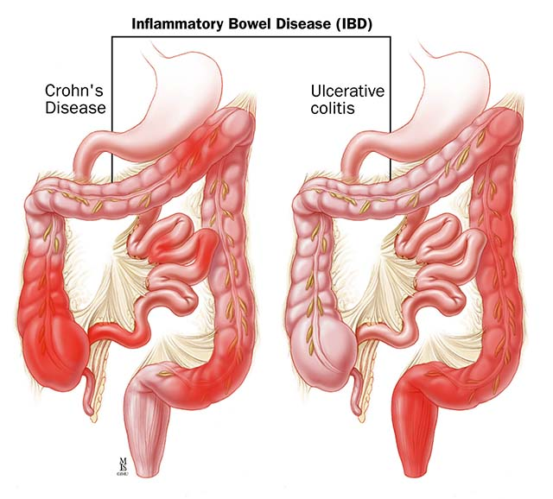
Background
Inflammatory bowel diseases (IBD) are chronic conditions that affects approximately 1.3 – 3 million people in the United States
1 of the top 5 most expensive GI conditions
More than $10 billion in the United States
Number one driver of healthcare costs in IBD patients is unplanned healthcare utilization ( hospitalizations/readmissions)
Medicare’s Readmissions Reduction Program
Evaluates 30-day readmission as a core component of hospital performance quality metric
Notes:
Brief background on our current topic. Inflammatory bowel diseases are chronic inflammatory gastrointestinal conditions that affects approximately 1.3 to 3 million people in the United States. There are two subtypes of IBD: crohn’s disease, which is inflammation that can occur anywhere along the GI tract from the mouth to the anus, and ulcerative colitis, which is inflammation localized only to the colon. IBD is one of the top 5 most expensive GI conditions. In the United States, healthcare costs for IBD is estimated to be $10 billion in the United States. You may have seen some of the TV commercials for some treatment for IBD such as Remicade, Humira, Xeljanz, etc. While these medications are very expensive, the number one driver of healthcare costs in IBD is unplanned healthcare utilization - which are hospitalizations and readmissions. In an attempt to measure hospital quality and reduce hospital readmissions, Medicare developed a program called the readmissions program, which evaluates 30-day readmission as a core component of hospital performance quality metric. Payments to hospital are tied to this 30-day readmission metric.

Slide 5
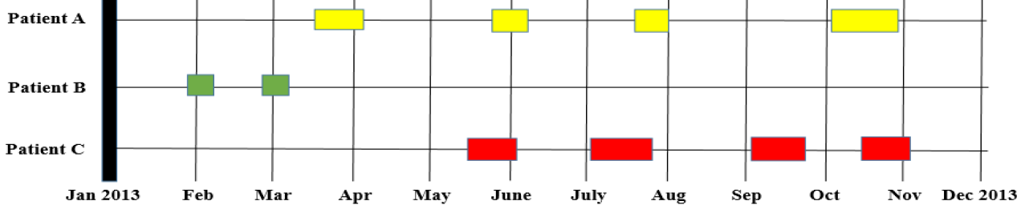
Background
30-day readmission fails to capture overall burden of hospitalization
Some patients who are ‘high consumers’ of healthcare may not be admitted within 30-days of admission (patient A)
Even among patients with 30-day readmission, there may be some who have multiple subsequent hospitalizations and others with just one-time readmission (patient B)
Patients may have varying lengths of hospitalization, with disproportionate costs (patient C)
Notes:
30-day readmission is a poor metric and does not accurately capture the burden of hospitalization. For example, some patients who are high consumers of healthcare may NOT be admitted within 30-days of admission. Even among patients with 30-day readmission, there may be some who have multiple hospitalizations and others with just one-time readmission. Patients may also have varying lengths of hospitalization, which are associated with disproportionate costs. This diagram is a pictorial representation of how 30-day may not be an accurate metric in measuring hospital quality.

Slide 6
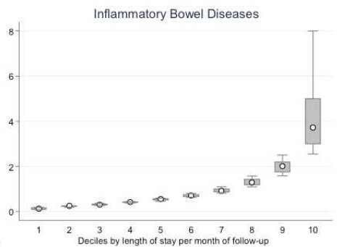
Aim
Primary Outcome
Characterize patients who are high-need, high-cost (HNHC)
Number of days spent in hospital per month
HNHC patients defined as patients in the highest decile by total days spent in hospital/month
Build a machine-learning algorithm to identify factors associated with HNHC patients
Secondary Outcome
Compare performance of machine-learning algorithm to traditional logistic regression model
Total length of stay across all hospitalizations
Number of days spent in hospital per month
Total follow-up months
Notes:
Our hypothesis is that there is a subset of patients who utilize a significant amount of healthcare resources (as measured by hospitalizations) and if we can identify these patients, then we can develop targeted interventions aimed at these patients to reduce healthcare costs. To identify these patients, we decided to develop a different metric than 30-day readmission. Our metric is number of days spent in the hospital per month. The idea behind this metric is that patients who spend a significant amount of time in the hospital are the people who use the most healthcare resources and they may not be captured by looking at 30-day readmission. This metric was calculated by summing the total length of stay across all hospitalizations and divide this by the total follow-up months for a given patient. The reason why we divided by the total follow-up months is because not all patients in our dataset have the same follow-up time and we wanted to be able to normalize our data. Based on this metric, we split the values into deciles and defined patients in the top decile as HNHC patients - the patients who use the most resources. After we identified these patients, we sought to build a machine-learning algorithm to identify factors associated with these HNHC patients. Our secondary outcome was compare the performance of our algorithm to traditional logistic regression model.

Slide 7
Methods
Nationwide Readmissions Database 2013
All-payer database of hospital inpatient stays - contains only administrative claims code.
Longitudinally captures >85% of inpatient discharges
21 state inpatient databases
We constructed a retrospective cohort
Inclusion criteria
Adults with 1 or more hospitalizations between January and June 2013 with a primary or secondary discharge diagnosis of IBD
Exclusion criteria
Non-adults
Missing data
Notes:
NRD 2013 - contains ADMINISTRATIVE claims code.

Slide 8
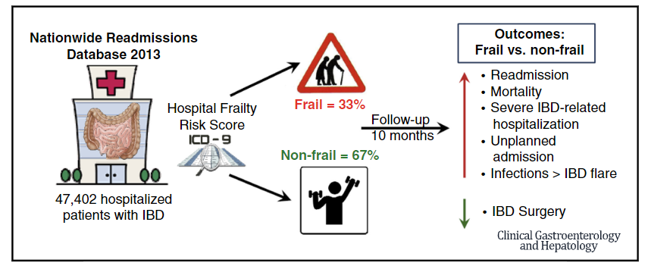
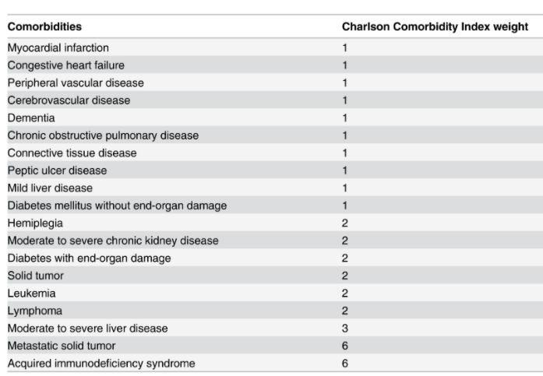
Methods
Definitions
Frailty risk score
Biological reserve and function status
Charlson-comorbidity index
Measurement of burden of medical comorbidities
Notes:
Two key features we wanted to highlight here, which are frailty risk score and charlson-comorbidity index. Frailty is this concept that we should not assess someone’s health status by their age alone: for example, a 65 year old patient who can run marathons is very different than a patient who can barely walk a block without having to stop to take their breath. Frailty is the idea that we should be assessing people’s biologic reserve and functional status and not their age. Therefore, a risk score was developed to characterize a patient’s functional status and patients with a higher risk score are more likely to experience adverse health outcomes. With regards to charlson-comorbidity index, this is a metric that captures the burden of medical comorbidities that a patient has - the higher the number, the more “sick” the patient is.

Slide 9
Methods
Inflammatory bowel disease
Clinical Classifications Software (CCS) for International Classification of Diseases, 9th Revision-Clinical Modification (ICD-9-CM), developed by Healthcare Cost and Utilization Project (HCUP)
Patients with IBD were identified with a CCS code 144
CCS is a categorization scheme for diagnoses and procedures that collapses ICD-9-CM’s extensive codes into small number of categories --> clinically meaningful and more useful for presenting descriptive statistics
555.0, 555.1, 555.2, 555.9, 556.0, 556.1, 556.2, 556.3, 556.6, 556.8
Total of 14,325,172 discharge records included in the NRD 2013
94,498 records were identified for analysis
47,402 unique patients with index hospitalizations between January and June 2013
Notes:
To define our cohort we used a combination of ICD-9 codes and a classification scheme to make ICD-9 codes easily interpretable. From more than 14,000,000 records, we identified 47,402 unique patients

Slide 10
Results

Slide 11
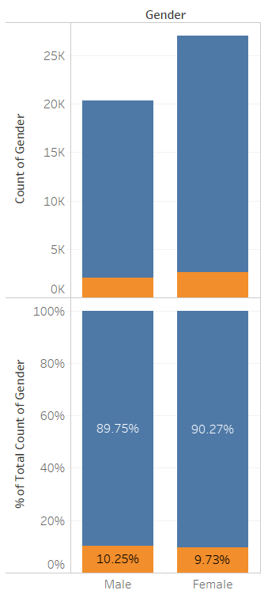
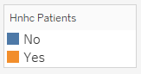
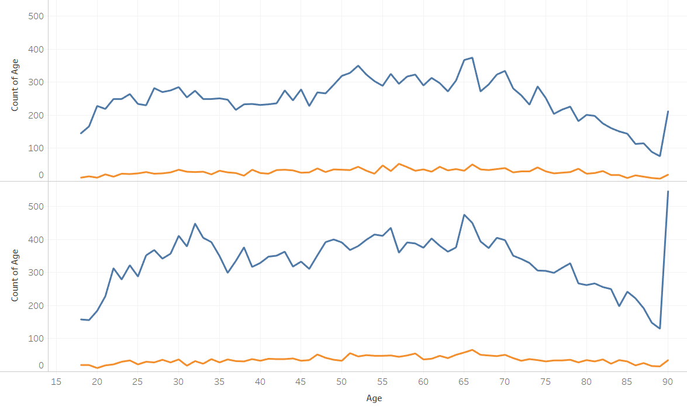
Distribution of HnHc IBD Patients Across Ages and Genders
Male
Female
Notes:
By definition, 10% of patients are high need, high cost and so it’s no surprise that non-HnHc outnumber HnHc patients. What was interesting though is that this 10% distribution appears to generally hold true for both genders and across age groups, the exceptions being patients that are on the very young and very old sides of the spectrum. We expected to see higher numbers of HnHc patients as age increases, which did not appear to be the case here. However, that may be due in part because there are fewer elderly patients overall.

Slide 12
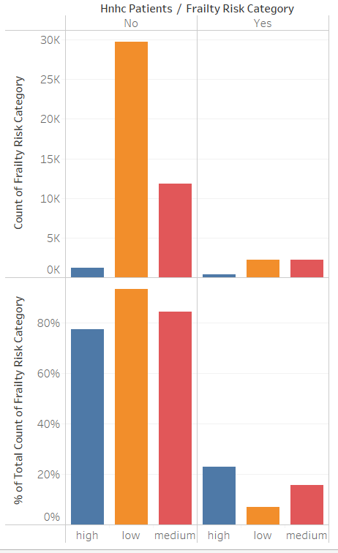
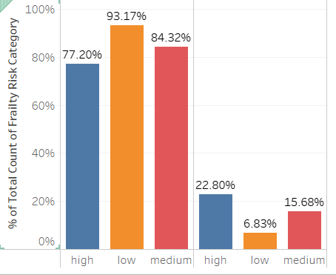
Frail IBD Patients are Disproportionately More Likely to be HnHc
Notes:
Highly frail patients make up the lowest overall proportion of both HnHc and Non-HnHc Patients. However, of the the largest proportion of highly frail patients are HnHc when compared to low and medium frailty patients.

Slide 13
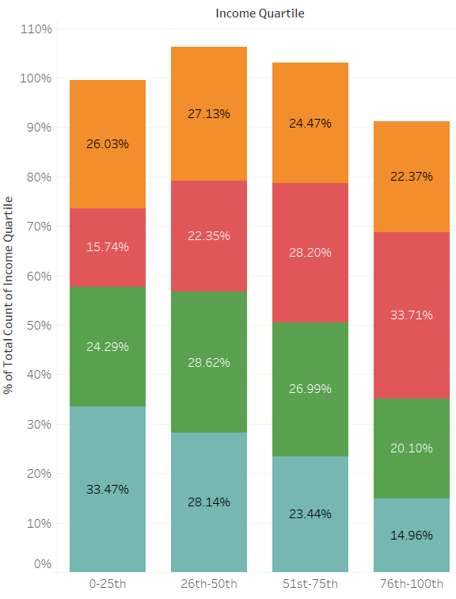
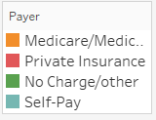
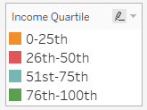
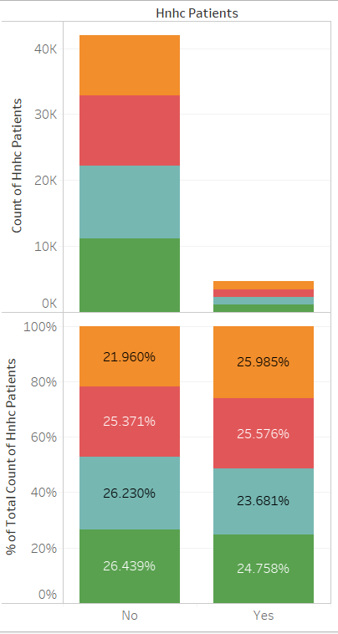
The Largest Proportion Self-Pay IBD Patients Belong to the Lowest Income Quartile; HnHc Patients Skew Slightly Toward Lower Income Quartiles
Notes:
Here we analyzed all patients by income and payer information to understand the socioeconomic backgrounds of these patients. This was eye-opening. As you can see here, the largest proportion of self-payers belong to the lowest income quartile. Those who are paying for their own healthcare may also be the ones who can least afford to do so.
On the right, when comparing HnHc patients to non-HnHc patients, the proportions of patients belonging to each income quartile appear to be quite similar. However, if you look closely, the proportion of non-HnHc patients belonging to two higher quartiles are slightly higher than that of HnHc patients. The inverse is true for the two lower quartiles, suggesting that HnHc patients are lower-income. The question is whether income is a significant factor in determining whether a patient will be HnHc. Stay tuned for the machine learning model to find out.

Slide 14
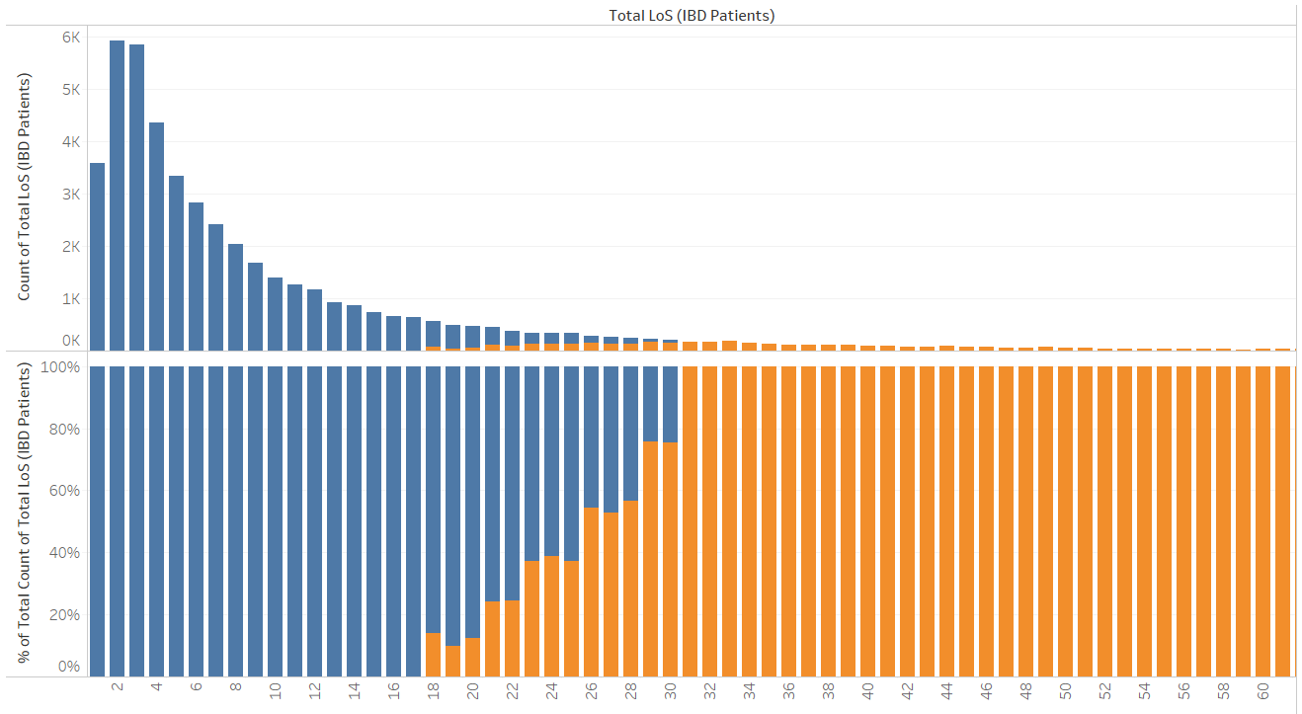
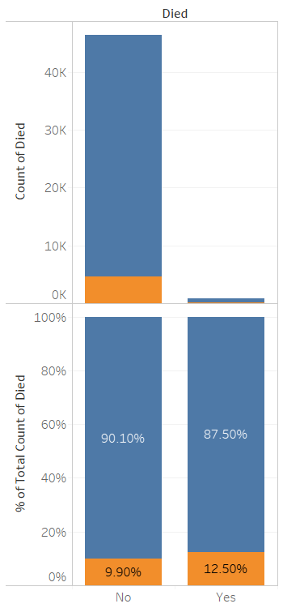
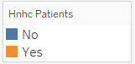
HnHc IBD Patients Are Characterized by Longer Hospitalization Times and Slightly Increased Mortality
Cumulative Length of Stay (days)
Notes:
Lastly, the graph on the left is simply showing that High Need High Cost patients tend to spend more time in the hospital, and that makes perfect sense given the definition of high need high cost. However, despite its obvious nature, visualizing the data in this way ended up be absolutely critical to our model, and I’ll explain why a bit later. Finally, we also found that High Need High Cost patients also unfortunately have slightly increased mortality - so in spite of receiving more care and utilizing more resources, their survival rate is lower.

Slide 15
Prediction Models

Slide 16
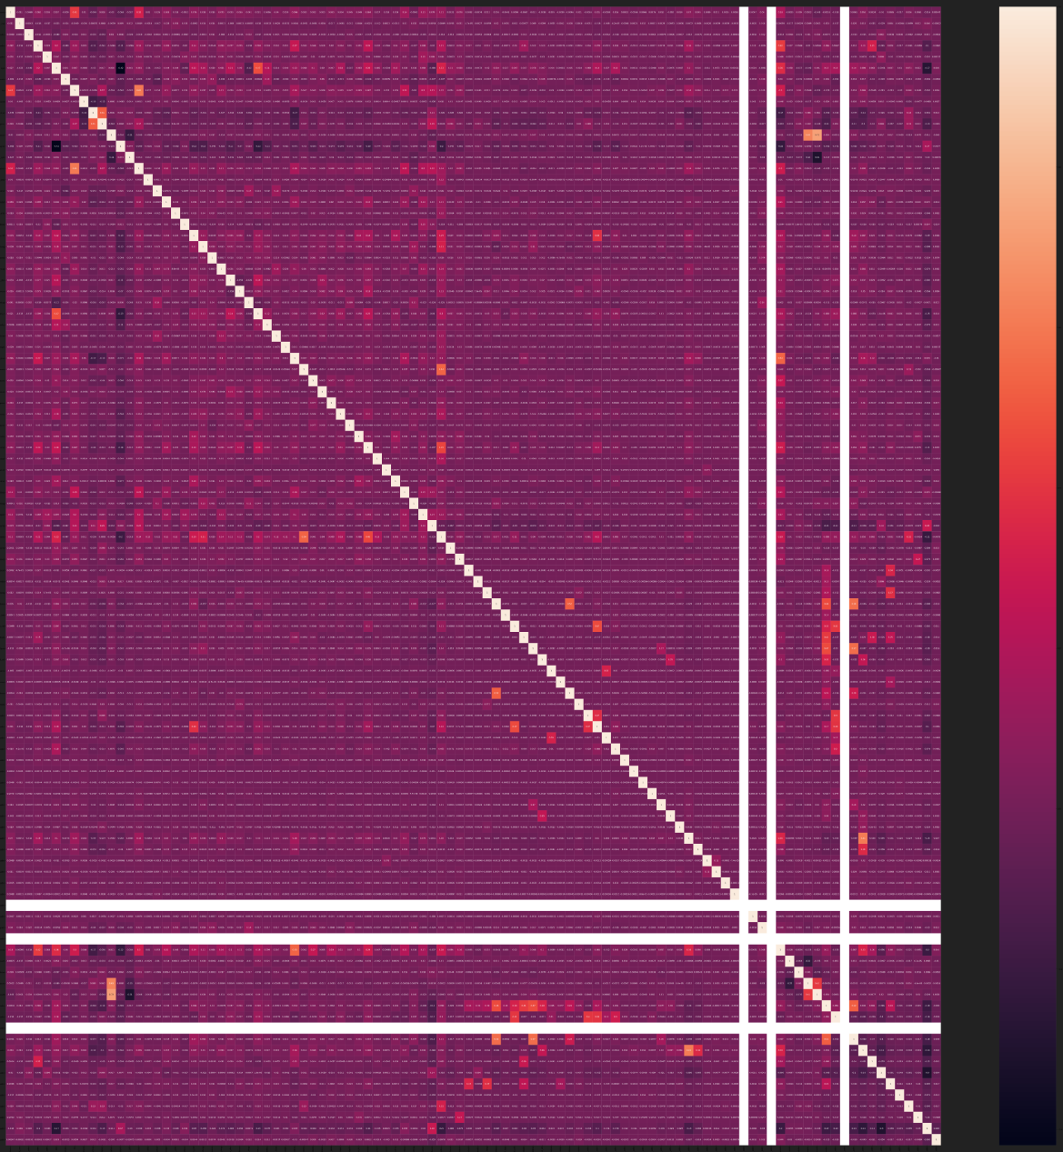
Feature Selection Process (Heatmap/Correlation Matrix)
This is a graphical representation of the variables in the dataset (over 100!)
Imagine having to handpick variables!
Notes:
Selecting by hand or trial and error could take hours or days and may still not end up with a valuable set of features.
We found and used a much better approach which we will discuss in the upcoming slides.

Slide 17
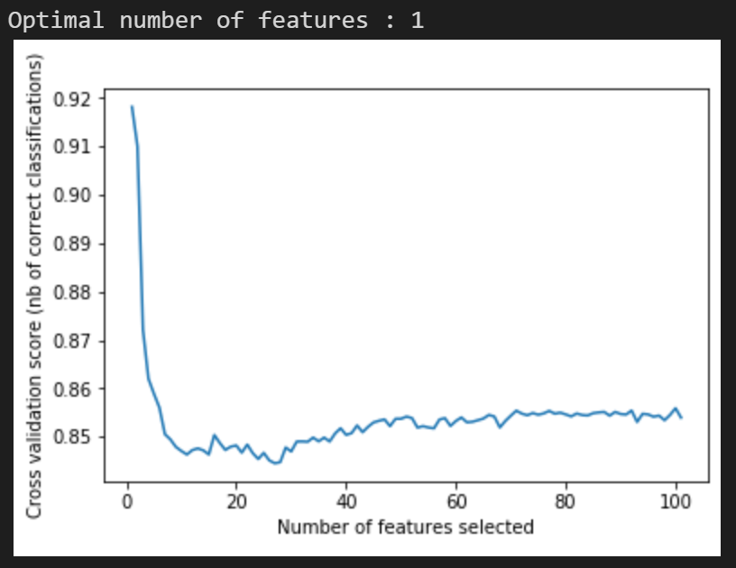
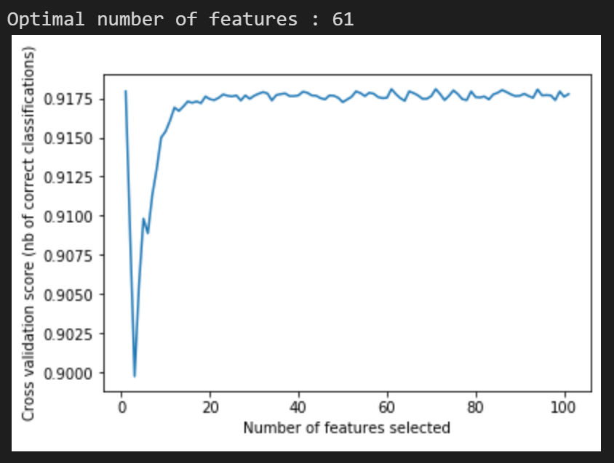
Feature Selection Process - Recursive Feature Elimination with Cross Validation (RFECV)
RFECV automatically cross validates and selects the optimal number of features.
Utilized DecisionTreeClassifier and returned 1 optimal feature. Ran model and received similar results as 5 feature model.
RandomForestClassifier took longer to run but returned 61 features. Was not significantly better than 5 feature model.
Possible overfitting
A.
B.
Notes:
Starting off with RFECV, a scikit learn library
Takes time
Does not necessarily return a set of features that can be easy to explain or interpret the data with
Can 1 feature really explain everything?

Slide 18
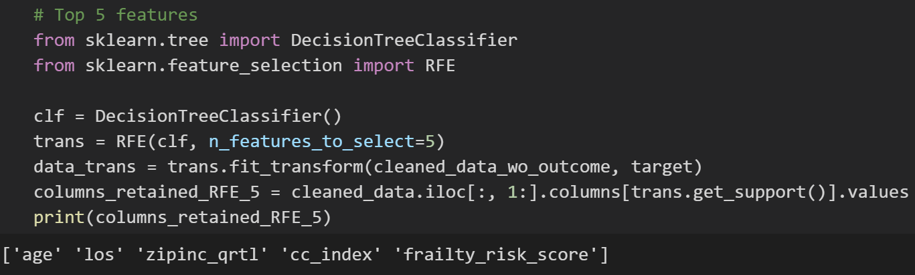
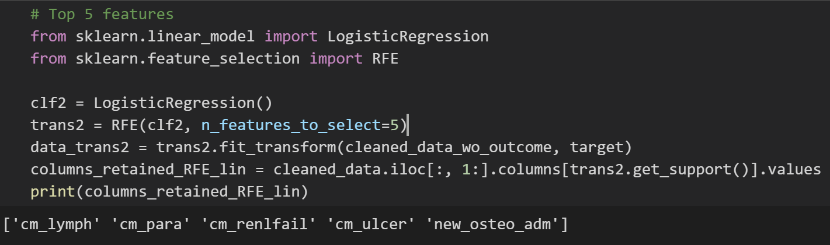
Feature Selection Process - Recursive Feature Elimination (RFE)
A.
B.
Pass in all 107 features and let RFE return the 5 most relevant features
This process utilizes backwards selection until the specified number of features remain by:
Ranking feature importance
Discarding least important features
Refitting the model with remaining features
Automates the process, faster than computationally expensive traditional methods
Logistic Regression Model selected completely different variables using RFE (Panel B vs Panel A)
Picked less clinically important variables
Notes:
A better approach is using a similar scikit learn library called RFE
Spoiler alert: RFE with decision tree classifier picked better predictor outcomes than the logistic regression (panel A vs panel B).

Slide 19
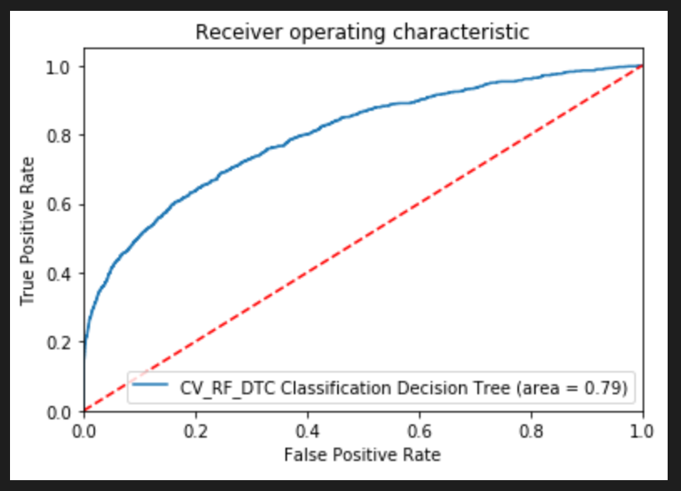
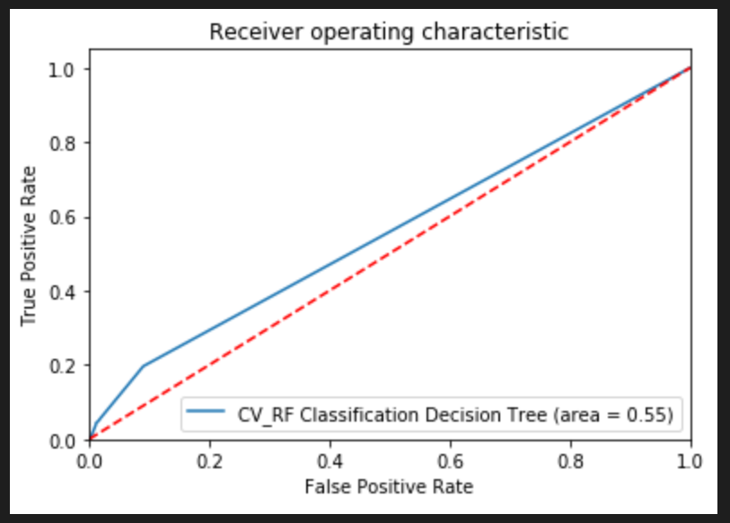
RFE: Logistic Regression vs Decision Tree Classifier
A.
Model selection is just as important as feature selection!
RFE using Decision Tree Classifier
5 features
0.79 AUC
RFE using Logistic Regression
5 features
0.55 AUC
B.
Notes:
To reiterate that point further, we can look at the AUC of each set of features from the previous slide. We will explain what AUC is a little later but just know the higher the area, the better your model is.
We can see the decision tree classifier model is significantly better.

Slide 20
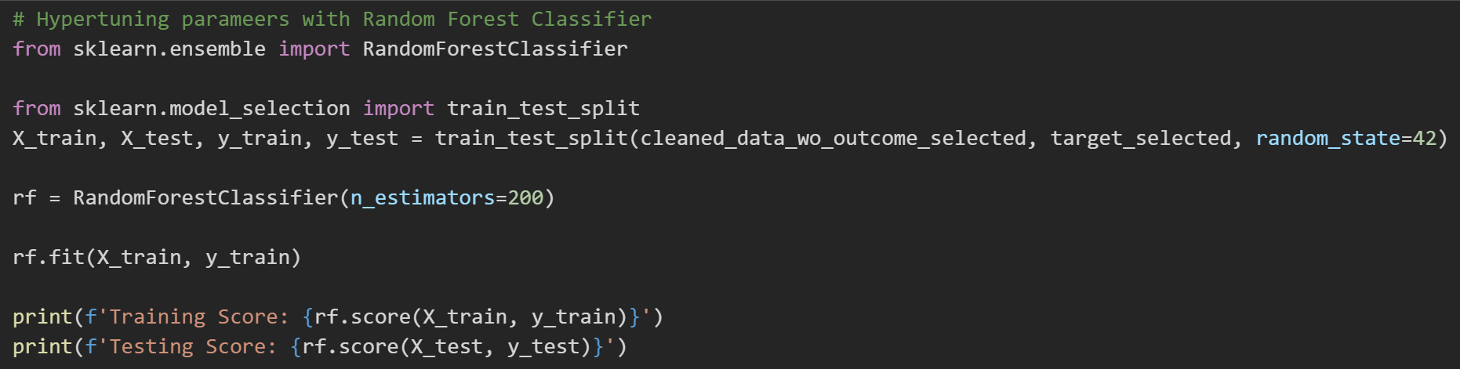
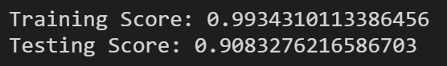
Random Forest Classifier
RandomForestClassifier returned a training score of 99.34% accuracy with 200 estimators and a testing score of 90.83%
But how does that compare to a Logistic Regression and can we hypertune the parameters for a more accurate score?

Slide 21
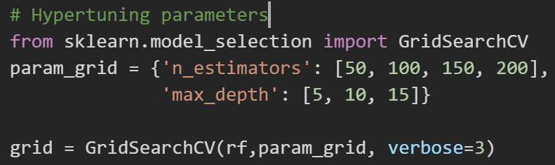
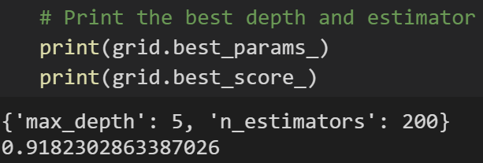
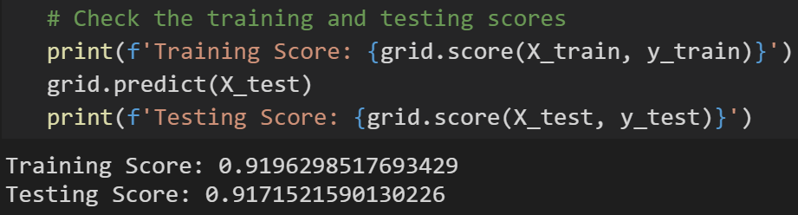
Random Forest Classifier - Hypertuning and GridSearch
GridSearchCV returned the optimal number of estimators and the max tree depth
Increased overall testing score by 0.88% to 91.71%

Slide 22
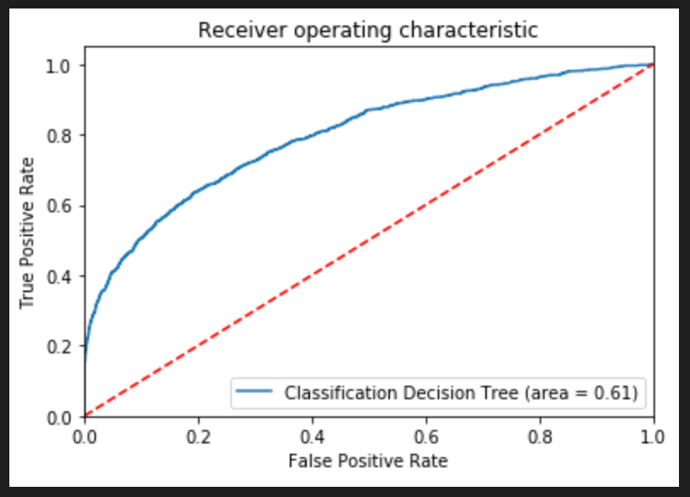
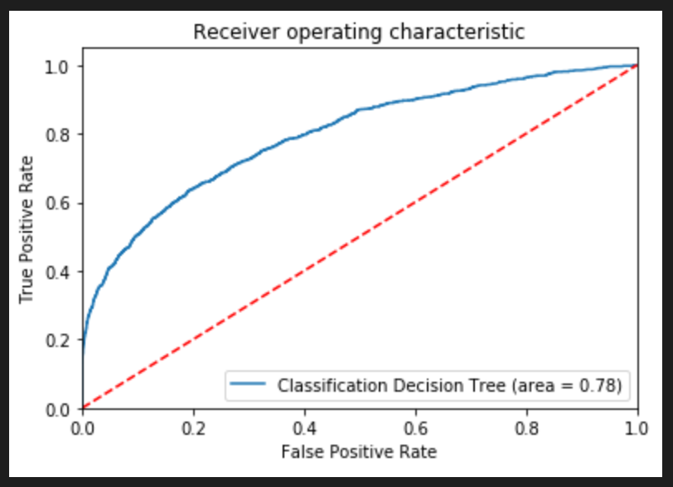
Random Forest Classifier - AUC-ROC
A.
Receiver Operating Characteristic (ROC) is the probability curve that plots True Positive Rate (TPR) versus False Positive Rate (FPR)
Area Under the Curve (AUC) measures the ability of the classifier to distinguish between classes
In English: This chart represents the ability of the model to distinguish between patients who are HnHc and who are not HnHc
After running cross validation, the AUC curve returned a significantly better result (0.78 vs 0.61) - panel B vs panel A
B.
Notes:
The AUC is a great way to double check that your model is actually performing well rather than just looking at the test score alone.
We were able to improve our AUC by using cross validation, which we will explain in the next slide

Slide 23
Random Forest Classifier - Cross-Validation
 | ROC-AUC (Train) | ROC-AUC (Test) | Precision (Train) | Precision (Test) | Recall (Train) | Recall (Test) | Accuracy (Train) | Accuracy (Test)
1 | 0.78873299 | 0.7820826 | 0.82278481 | 0.80508475 | 0.23325359 | 0.20430108 | 0.91872144 | 0.9158278
2 | 0.79165612 | 0.76068491 | 0.84691137 | 0.76470588 | 0.22631579 | 0.16774194 | 0.91895944 | 0.91197259
3 | 0.78748746 | 0.76739127 | 0.79023646 | 0.76510067 | 0.24784689 | 0.24516129 | 0.91862624 | 0.91732705
4 | 0.78618899 | 0.8058173 | 0.84432234 | 0.84732824 | 0.22057416 | 0.23870968 | 0.91841203 | 0.91989719
5 | 0.79007543 | 0.76650809 | 0.82964225 | 0.78512397 | 0.23301435 | 0.20430108 | 0.91893564 | 0.91518526
6 | 0.78826577 | 0.78812025 | 0.85078777 | 0.84166667 | 0.2195647 | 0.21767241 | 0.91850917 | 0.91816624
7 | 0.78871635 | 0.78196309 | 0.77155172 | 0.74342105 | 0.25687635 | 0.24353448 | 0.91848537 | 0.91645244
8 | 0.78604497 | 0.77968053 | 0.77540501 | 0.80952381 | 0.25185362 | 0.25646552 | 0.91829498 | 0.92009426
9 | 0.78873995 | 0.78509871 | 0.79937304 | 0.76433121 | 0.24396077 | 0.25862069 | 0.91867577 | 0.91838046
10 | 0.78701421 | 0.78421823 | 0.83462532 | 0.77372263 | 0.23176274 | 0.22844828 | 0.91898517 | 0.91666667
Notes:
Stable across 10 folds
Allows us to run multiple iterations using different splits and get a good average of what our model is capable of rather than just one run which could be high or low.

Slide 24
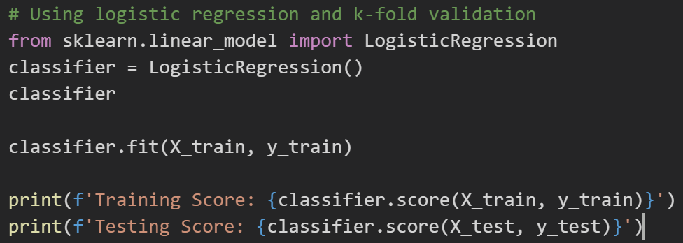
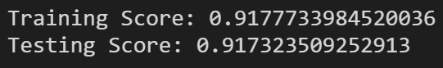
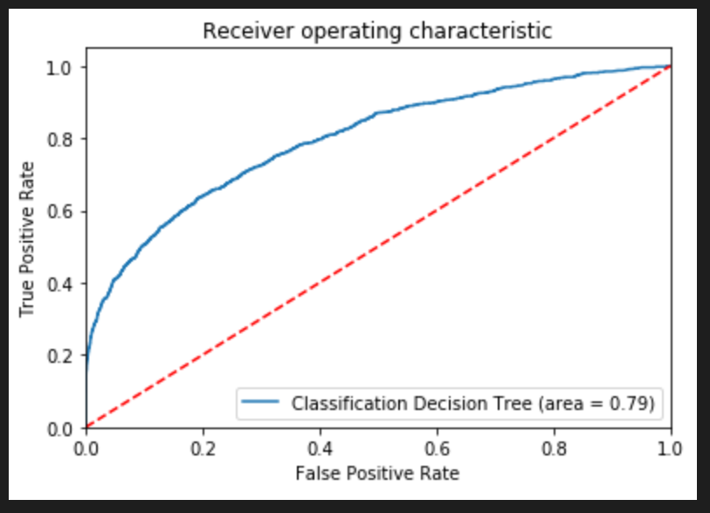
Logistic Regression - Using Python
Logistic Regression performed just as well as Random Forest
We ran this Logistic Regression in STATA as well and saw a similar result
Notes:
Nghia

Slide 25
Logistic Regression - Cross-Validation
 | ROC-AUC (Train) | ROC-AUC (Test) | Precision (Train) | Precision (Test) | Recall (Train) | Recall (Test) | Accuracy (Train) | Accuracy (Test)
1 | 0.78914104 | 0.78883015 | 0.76082328 | 0.75 | 0.25645933 | 0.23225806 | 0.91800743 | 0.9158278
2 | 0.79164575 | 0.76731249 | 0.76223776 | 0.69343066 | 0.26076555 | 0.20430108 | 0.91836443 | 0.91175841
3 | 0.79117502 | 0.7698894 | 0.75675676 | 0.76582278 | 0.25454545 | 0.26021505 | 0.91769802 | 0.91839794
4 | 0.78691871 | 0.81183793 | 0.75689405 | 0.7791411 | 0.24952153 | 0.27311828 | 0.91736481 | 0.91989719
5 | 0.78997671 | 0.78546673 | 0.75671853 | 0.73943662 | 0.25598086 | 0.22580645 | 0.91779322 | 0.91497109
6 | 0.78889382 | 0.79088573 | 0.7555876 | 0.78343949 | 0.25065774 | 0.26508621 | 0.91736678 | 0.91966581
7 | 0.78862672 | 0.79513866 | 0.75849602 | 0.75159236 | 0.25089691 | 0.25431034 | 0.91750958 | 0.91752356
8 | 0.78930692 | 0.79107311 | 0.7537797 | 0.82550336 | 0.25041856 | 0.26508621 | 0.91727158 | 0.92137961
9 | 0.78929842 | 0.78794313 | 0.75609756 | 0.75287356 | 0.2520928 | 0.28232759 | 0.91748578 | 0.91945159
10 | 0.78826266 | 0.79869259 | 0.76397967 | 0.73809524 | 0.25161445 | 0.26724138 | 0.91779518 | 0.91773779
Notes:
Nghia

Slide 26
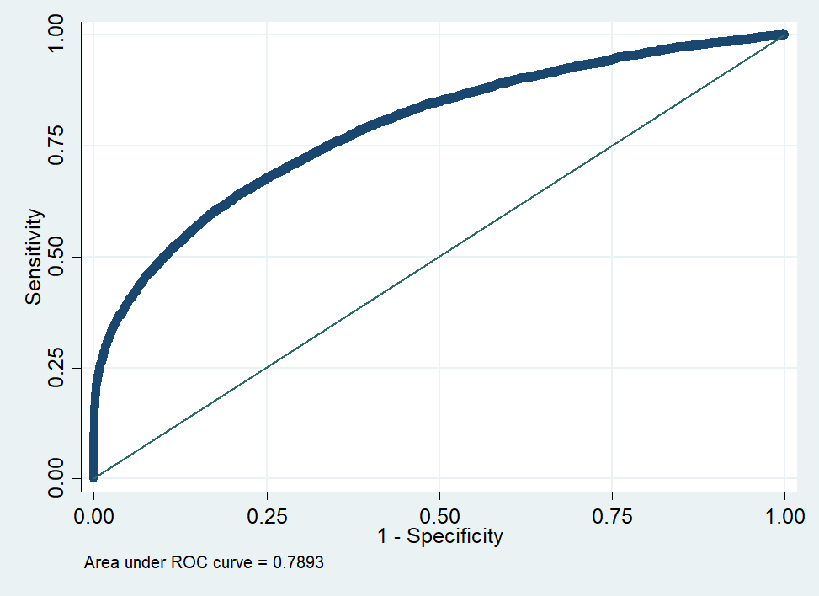
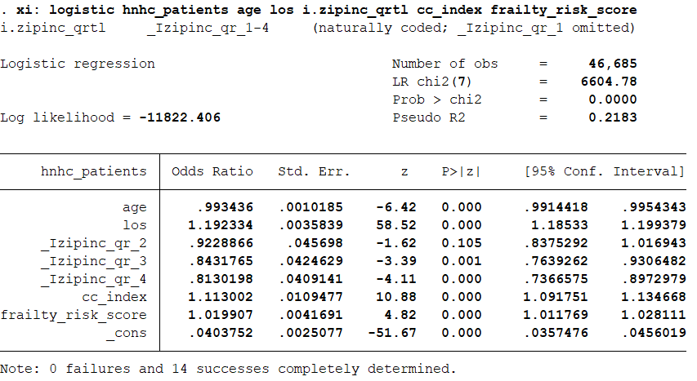
Logistic Regression - AUC-ROC (Using Stata)
Notes:
Same as python code!
Nghia

Slide 27
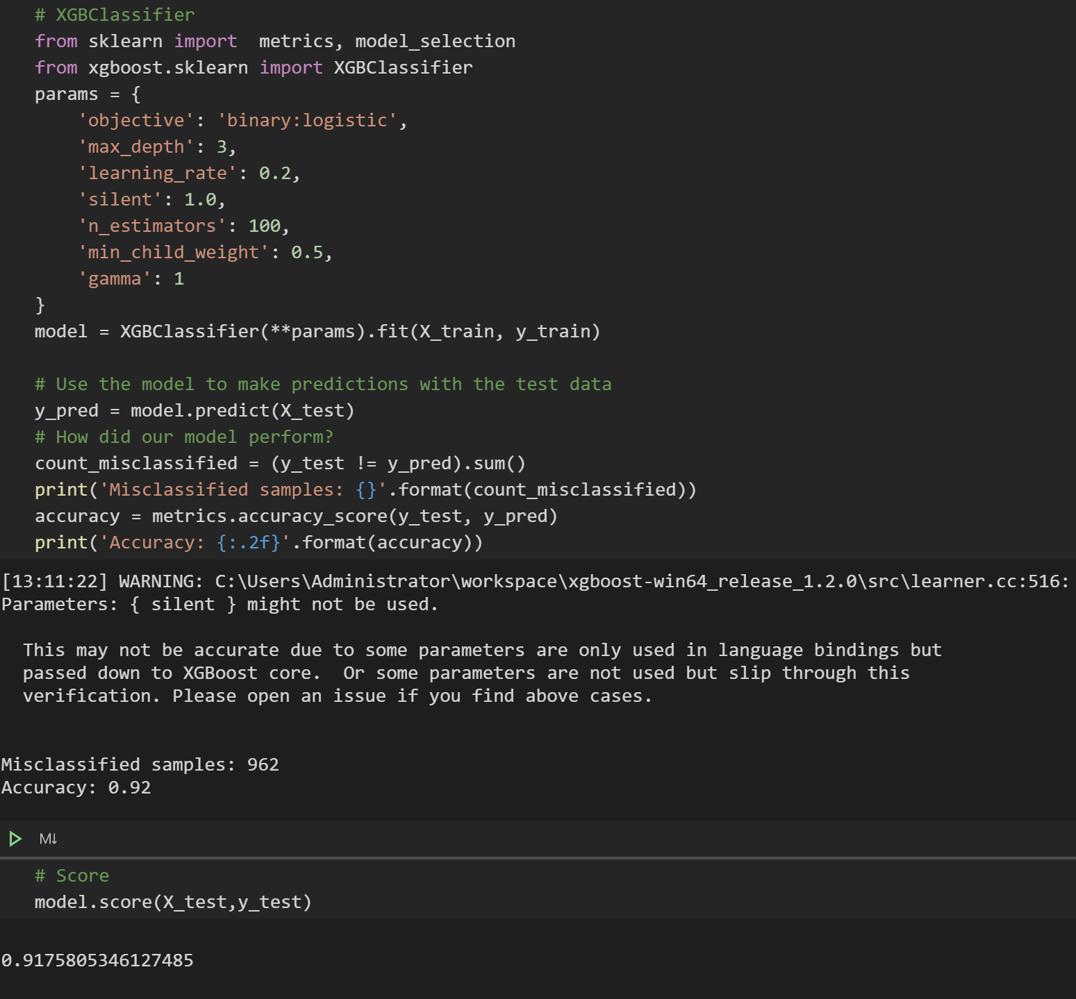
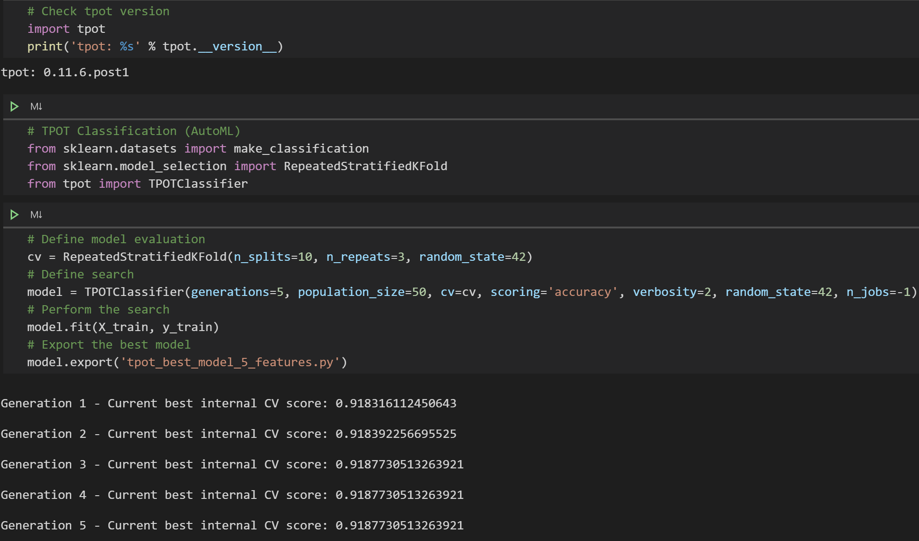
XGB and Tree-based Pipeline Optimization Tool (TPOT)
Notes:
XGBoost is a gradient boosting algorithm that is able to quickly return model accuracy using parallel tree boosting. Allows you to play around with the parameters and push the model score higher.
TPOT is an Auto Machine Learning tool that is capable of finding the best model and hyperparameters to use. It varies in run time but can take days if you want it to return the best model it is capable of creating with the data and parameters passed in. Support vector classifier
TPOT basically allows you to do everything that we did in the previous slides with minimal effort. Just create a test train split, pass in some parameters, and let it run (which can take hours to days). Returns a saved model with all of the hypertuned parameters.

Slide 28
Conclusions
Most important predictors for high-need, high-cost patients
Age
Initial length of hospital stay
Median household income
Charlson comorbidity index
Frailty risk score
Recursive feature elimination - Machine learning approach was better than logistic regression

Slide 29
Conclusions
Parsimonious model
Obtained through machine learning process
Ease of interpretability
Feature engineering is important!
Recursive feature elimination helps to find the most important features
More efficient than traditional approaches
Saves time and computing power
Cross-validation helps to improve your model
Saved by the viz - initially analyzed the bottom decile of patients by hospitalization time/month
Visualize your data for correctness before feeding it into any ML algorithm
Notes:
Using machine learning, we were able to obtain a parsimonious model, one that is sophisticated enough to make meaningful decisions, but not so greedy as to overfit the training data and unable to be generalized. Our goal was to have a model that was easy to interpret and explain. To that end, feature engineering was absolutely critical. With over 100 features, it would be been insane to try to make a model that fits all of them. By using RFE, we pared down our feature set to a managable size that actually made intuitive sense.
By the same token

Slide 30

And most importantly...

Slide 31
Acknowledgements
Alan Cecil
Peter Chen
Our classmates

Slide 32


